Slide 1
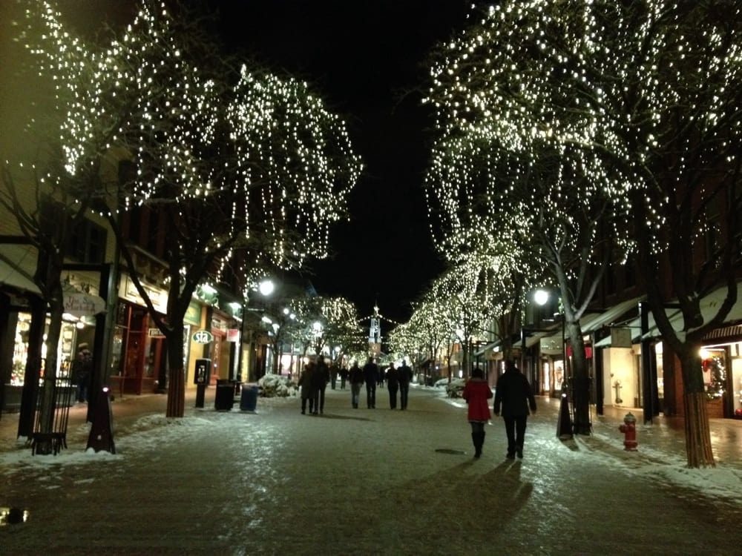
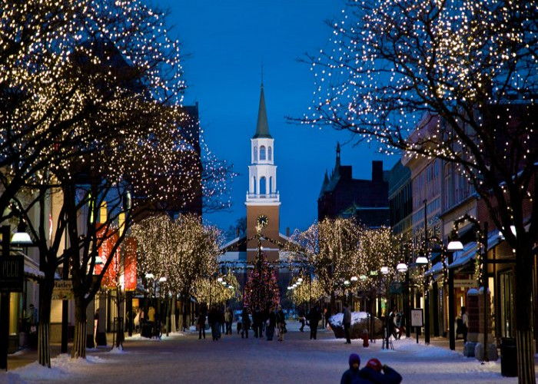
Church Street www.churchstmarketplace.com is a pedestrian street in Downtown Burlington offering you a wide range of cuisines: Italian, Asian restaurants, sandwich shops, pubs and much more. Not far from there, you will also find Leunig's bistro & café, The Farmhouse Tap & Grill, American Flatbread, Magnolia, Revolution Kitchen, Pizzeria Verita, Trattoria Delia and the famous Hen of the Wood. Bon appétit !
Hôtel Hilton

